Slide 1

Large-Scale Face Recognition
Lei Zhang
Microsoft
October 2, 2018

Slide 2
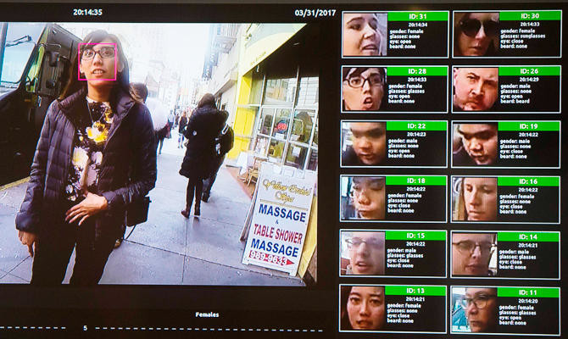
Face Recognition
Face recognition has been greatly advanced in recent years due to the breakthrough in deep learning
Many real applications
Security & law enforcement
Financial authentication
Airports
Brands & PR agencies
Targeted advertising
…
http://www.arabnews.com/node/1339101/science-technology

Slide 3
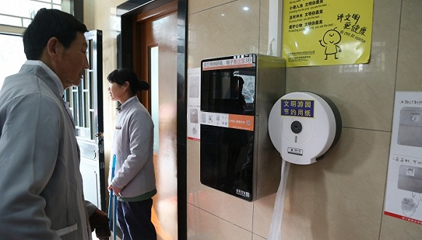
Chinese park installs facial recognition software to stop toilet paper thieves, 03/2017

Slide 4
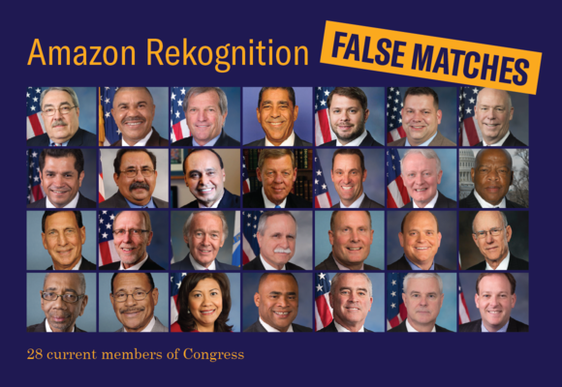
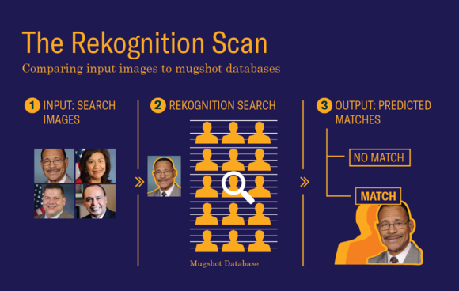
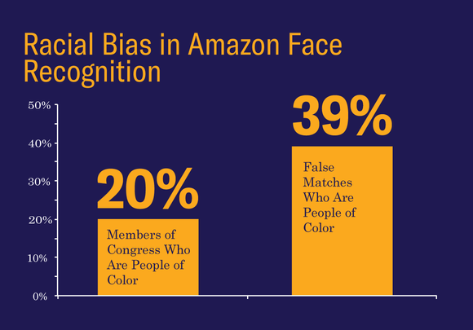
Amazon’s Face Recognition Falsely Matched 28 Members of Congress With Mugshots, 07/2018

Slide 5
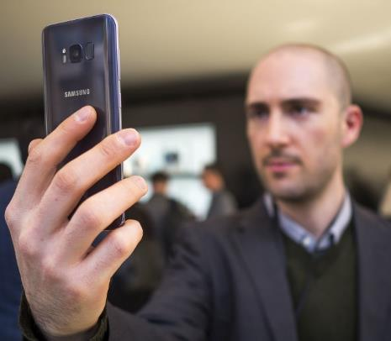
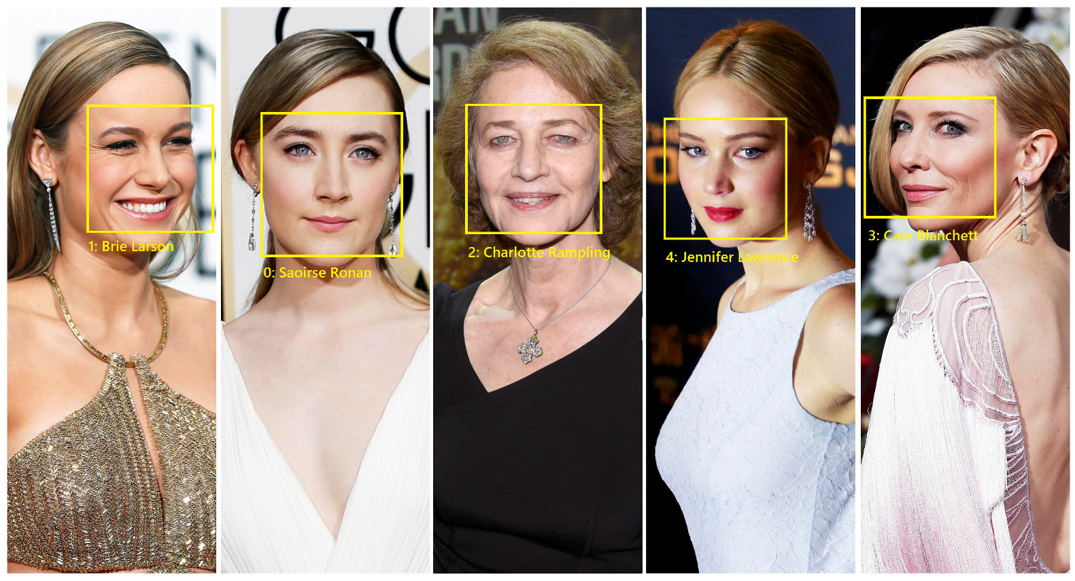
Face Recognition – Problem Definition
Face verification – 1 vs. 1
Given two faces, answer if they are the same person or not
Example application: Phone unlocking
Face identification – 1 vs. N
Given one face, answer whom he/she is among N people, or reject
Example application: Celebrity recognition

Slide 6
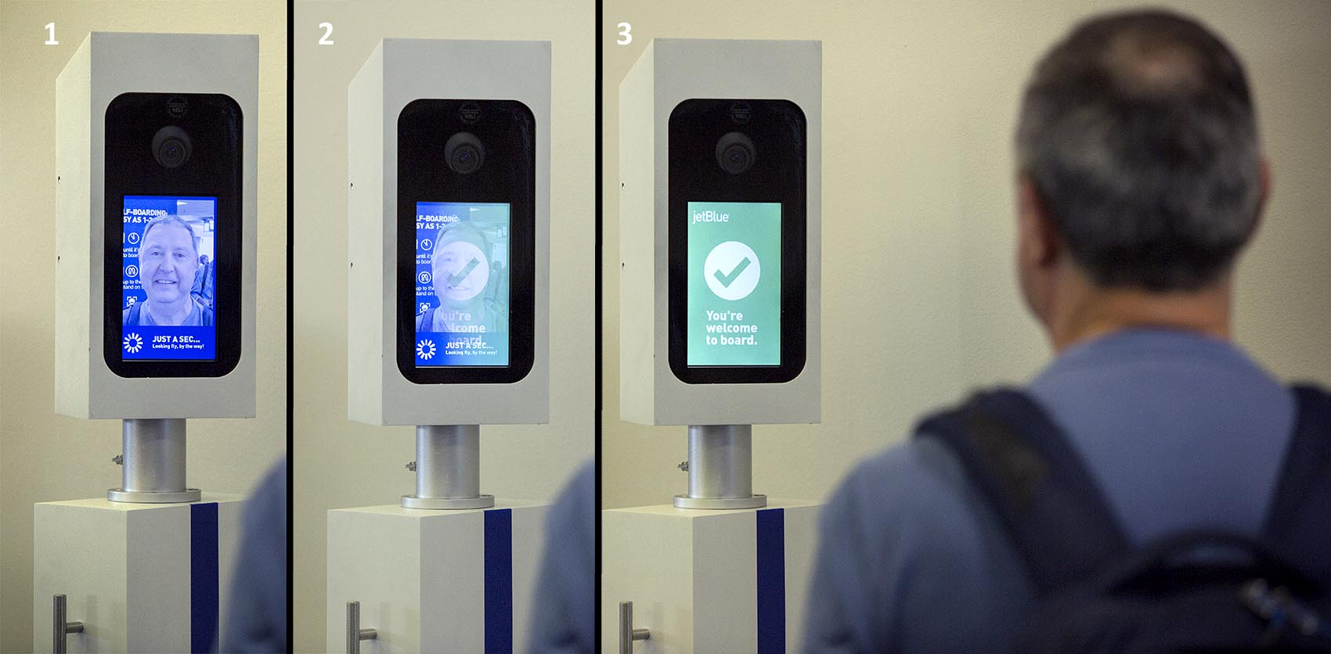
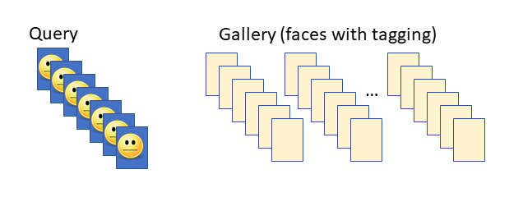
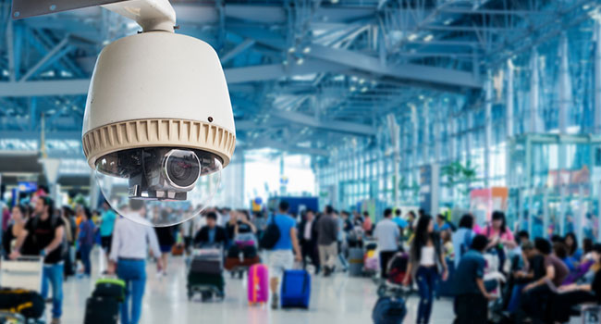
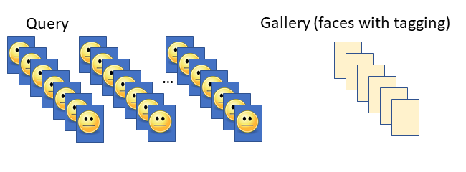
Face Recognition – Problem Definition
Face Identification – M vs. N (M << N)
Face Identification – M vs. N (M >> N)

Slide 7
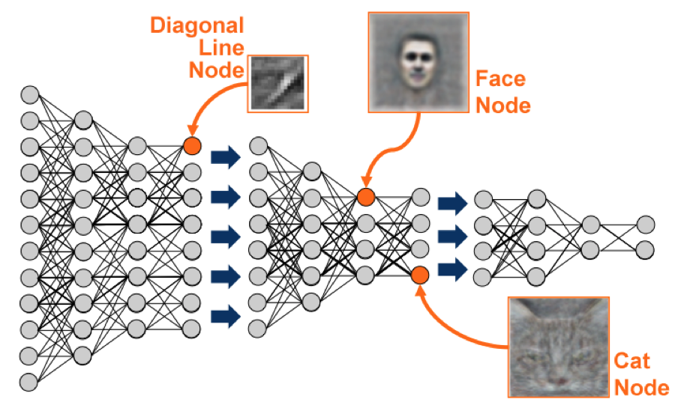
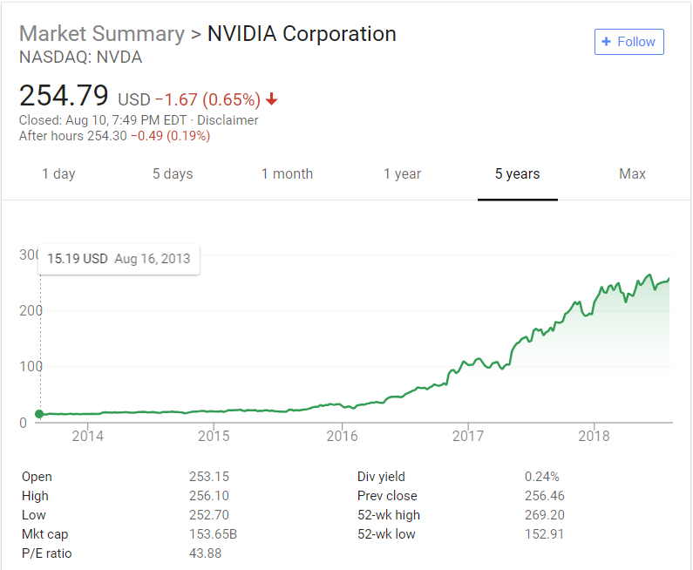
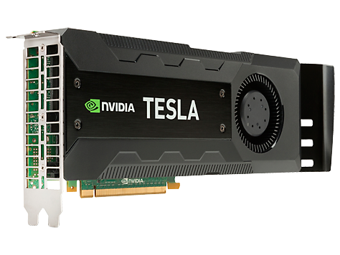
Driving Forces Behind Face Recognition
?
Data
Computing Power
Algorithm

Slide 8
Public (and Private) Face Datasets
Dataset | Public? | # of People | # of Faces
LFW | public | 5k | 13k
YFD | public | 1.5k | 3.4 k videos
CelebFaces | public | 10k | 202k
CASIA-WebFace | public | 10k | 500k
MS-Celeb-1M | public | 100k | About 8,456k
Facebook | private | 4k | 4,400k
Google | private | 8000k | 100-200m

Slide 9
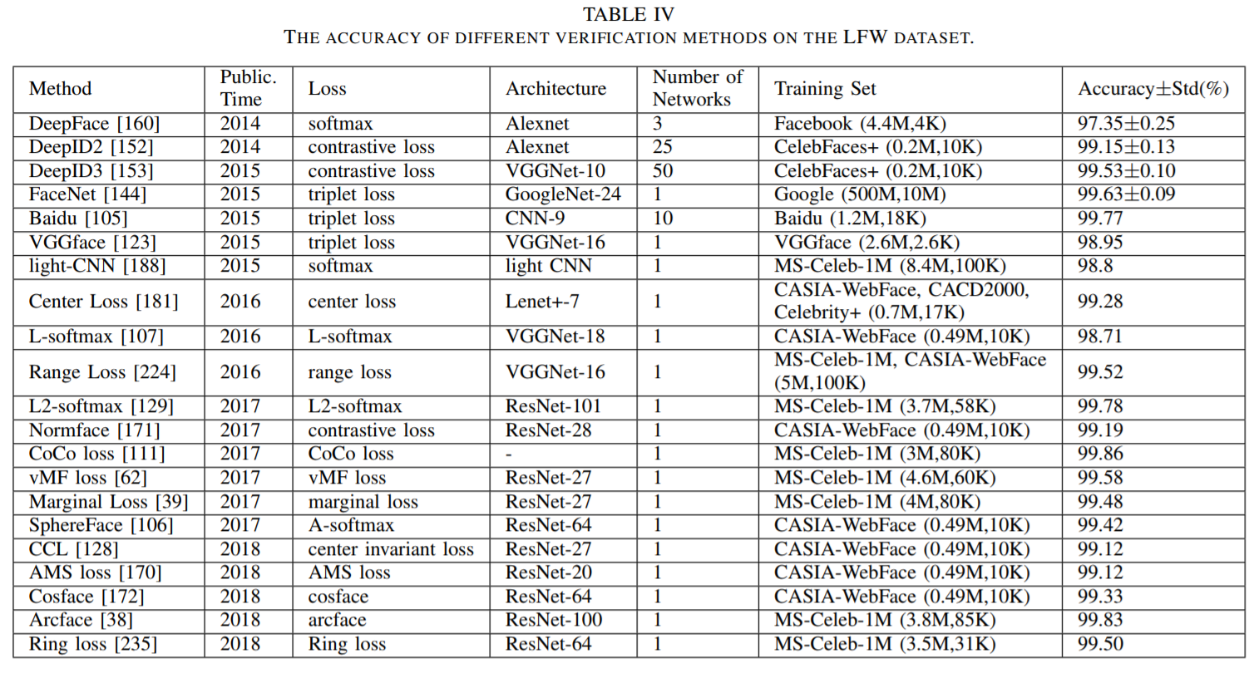
Mei Wang and Weihong Deng. "Deep Face Recognition: A Survey." arXiv preprint arXiv:1804.06655 (2018). v7, 9/28/2018

Slide 10
The Story Behind MS-Celeb-1M

Slide 11
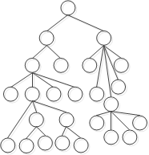
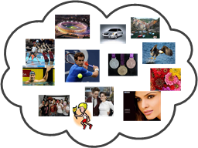
A Grand Challenge in Search Engine
– Can We Recognize As Many As Possible Entities on the Web?
– How Many? And How Accurate?
Knowledge Base
1B entities
How to collect data?
Image Search Index
10B+ Images
?
People
Location
Movie
Book
Animal
…
How to recognize?

Slide 12


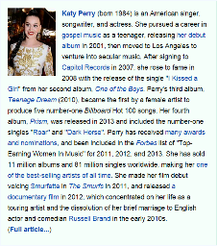


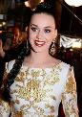















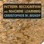





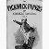








Image Entity Linking Framework
Ground Truth Data
Matching Features
 | Harry Shum | Yes
 | Harry Shum Jr. | No
 | Harry Shum Jr. | Yes
 | 2014 Ferrari 458 | Yes
2 | 0 | 1 | 1 | …
0 | 1 | 1 | 0 | …
3 | 1 | 1 | 0 | …
1 | 0 | 3 | 2 | …
Entity Detection
Text Consistency Model
Propagation
Image Index
Image Index
e1,e2
e1
e1
e2
e3
 | e1 | √
 | e2 | ×
 | e3 | ×
e1,e3
e2
entity score,
page context
Visual Consistency Model
People
Company
Book
University

Slide 13
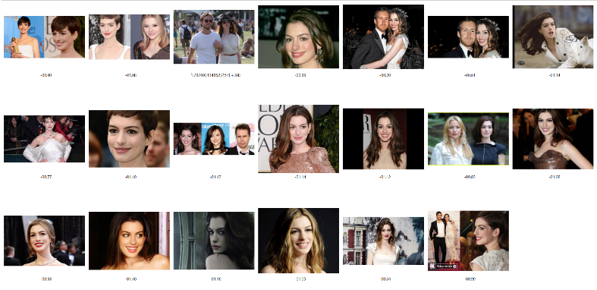
Overall Results
People Segment
More segments (ongoing):
Location/attraction entities
Movie entities
Animal/dog breed/cat breed
Plant/flower
…
 | Coverage (# Image) | # Entity | Precision*
V2 (Text + Visual) | 93M (+70%) | 300K | 98.5%
V1 (Text) | 54M | 300K | 98.6%
* Measured on 2.5K name queries and their top 10 resulting images
Anne Hathaway (22K images)
Justine Bieber (133K images)
Selena Gomez (128K images)
Miley Cyrus (111K images)
…

Slide 14
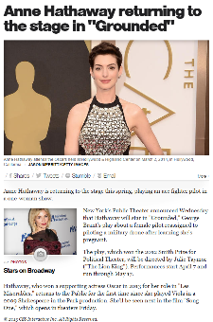
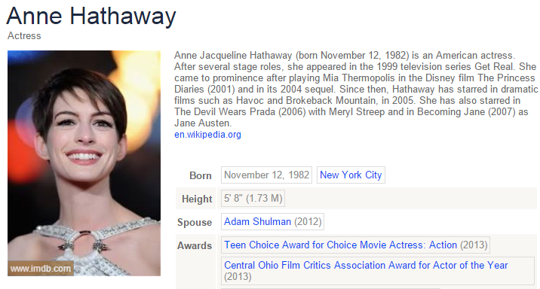
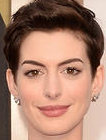
Instance-based KNN Search
Key Idea
Based on the high quality stamping results, build a high precision celebrity recognition engine
Weaknesses
Sensitive to noise
Limited generalization ability
Input: image (and page)
Face detection
KNN search
15ms/image
Output: image and Satori pair
High quality stamping results for people segment

Slide 15
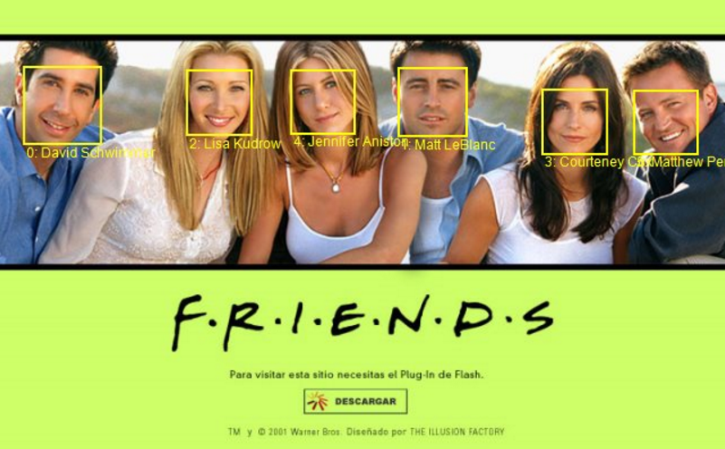
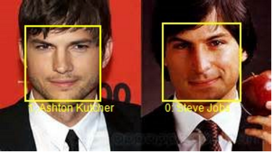
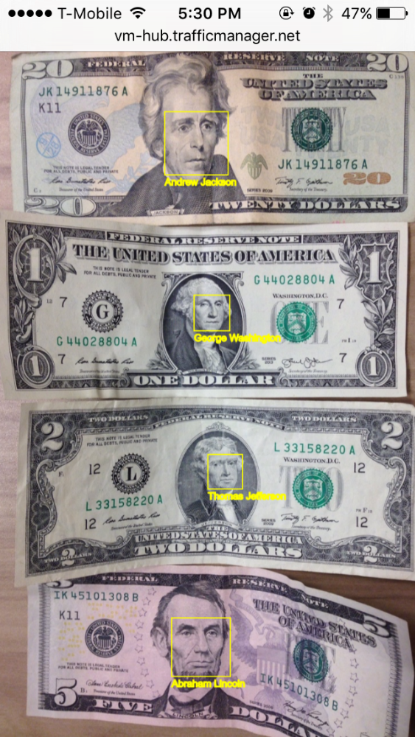
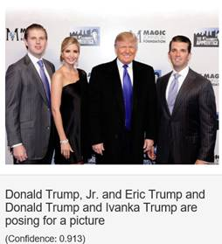
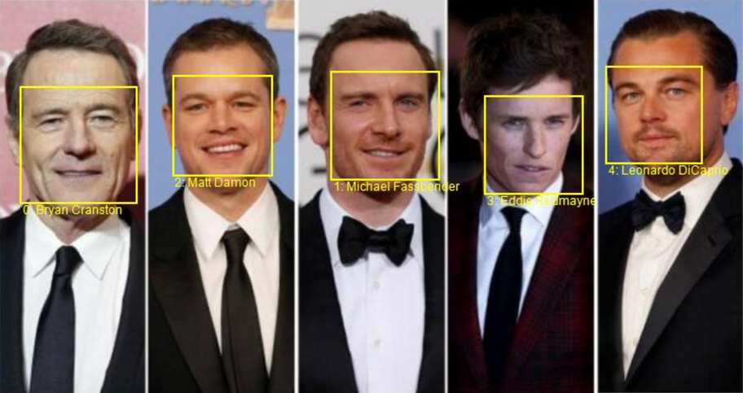
One Step Further – Celebrity Recognition
Can we recognize people purely based on image pixels?

Slide 16
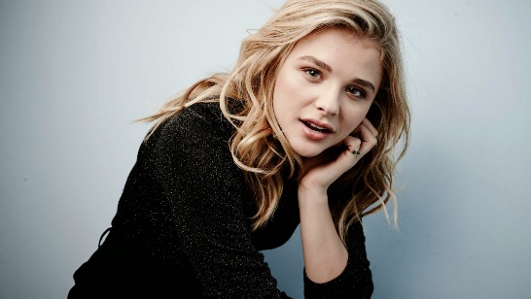

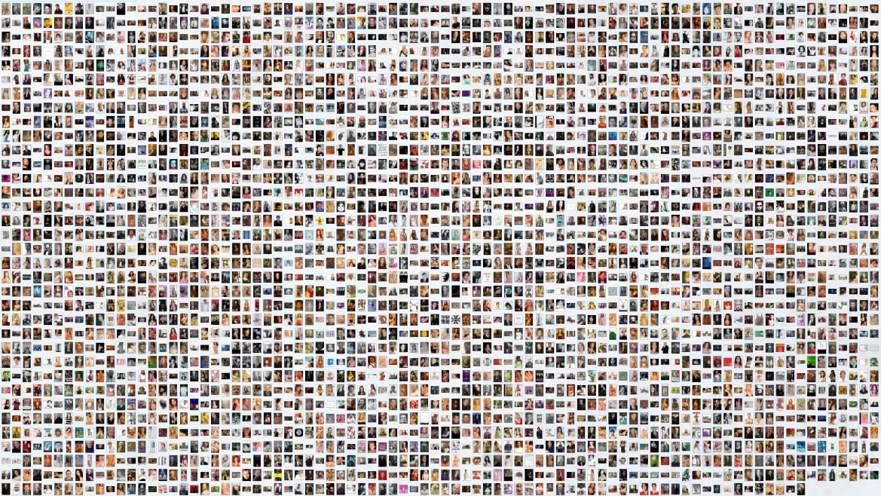

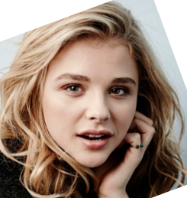
Model-based People Identification
Typical Convolutional Neural Network: AlexNet, VGG, ResNet, etc.
Chloë Grace Moretz
…
convolutional + pooling layers
fully connected layers
N-class prediction

Slide 17

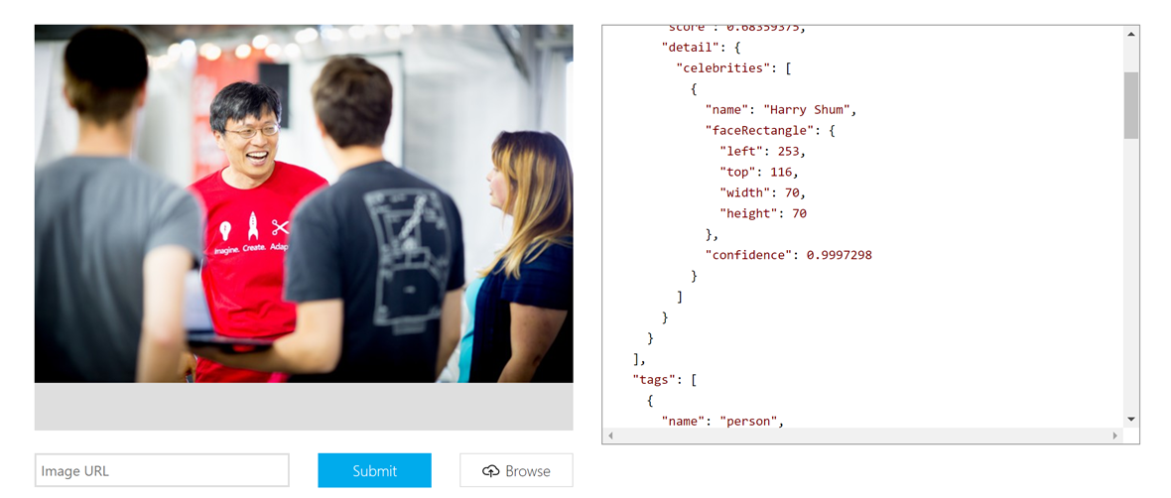
In Microsoft Cognitive Service
Recognize celebrities
The Celebrity Model is an example of Domain Specific Models. Our new celebrity recognition model recognizes 200K celebrities from business, politics, sports and entertainment around the World.

Slide 18
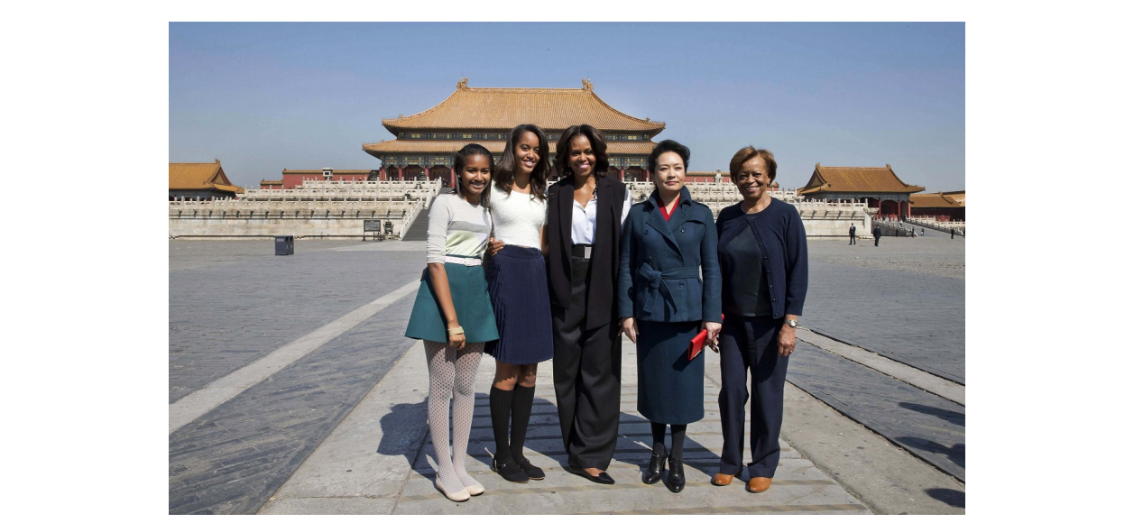

In Image Caption (captionbot.ai)
Kenneth Tran, et al, CVPRW 2016
Sasha Obama, Malia Obama, Michelle Obama, Peng Liyuan et al. posing for a picture with Forbidden City in the background.

Slide 19

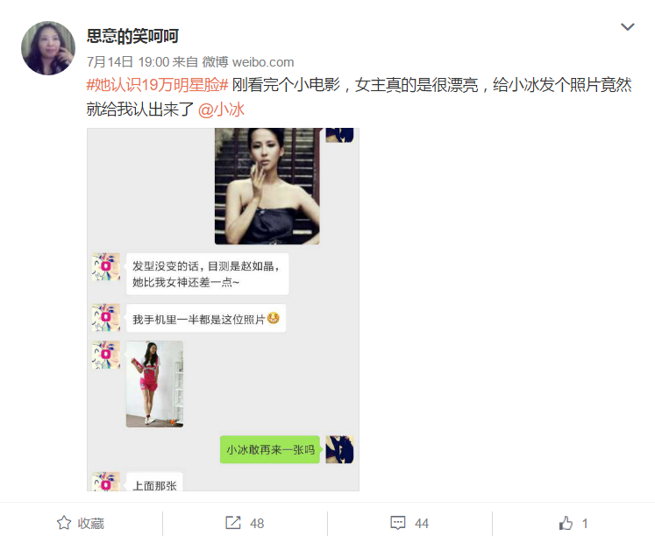
In XiaoIce (小冰)

Slide 20
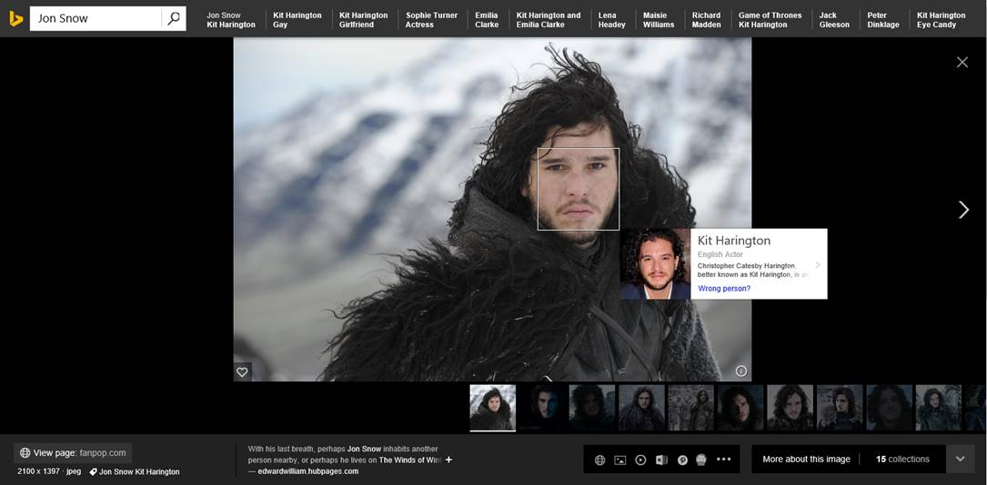
In Bing Image Search
More examples: steve jobs actor, friends

Slide 21
Towards Best Face Recognition Feature
Typical Convolutional Neural Network: AlexNet, VGG, ResNet, etc.
Chloë Grace Moretz
…
convolutional + pooling layers
fully connected layers
N-class prediction

Slide 22
Towards Best Face Recognition Feature
Typical Convolutional Neural Network: AlexNet, VGG, ResNet, etc.
…
Face Recognition Feature
convolutional + pooling layers
fully connected layers

Slide 23
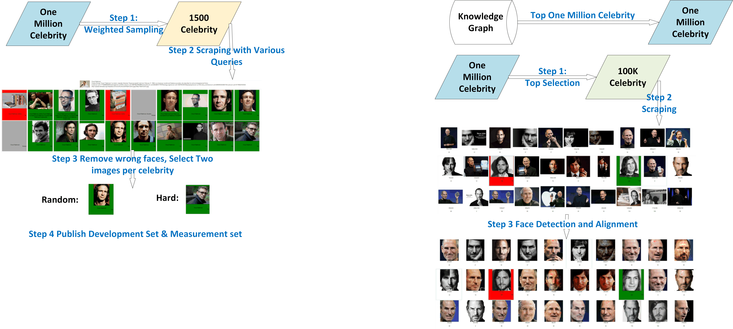
Making Data Public – Training Data
Freebase
Top 1M Celeb
Top 100K Celeb
Top 100K celebrity
About 10M images
Noisy label
Cropped/Aligned versions

Slide 24
Making Data Public – Measurement Data
Freebase
Top 1M Celeb
1,500 Celeb
 |  | # of Images | GT Published
Development Set | Random (Easy) | 500 | Yes
 | Hard | 500 | Yes
Measurement Set | Random (Easy) | 1000 | No
 | Hard | 1000 | No

Slide 25
Download links
Training data
https://www.msceleb.org/download/cropped
https://www.msceleb.org/download/aligned
Development data
https://www.msceleb.org/download/devset
Yandong Guo, Lei Zhang, Yuxiao Hu, Xiaodong Guo, Jianfeng Gao. MS-Celeb-1M: A dataset and benchmark for large-scale face recognition. ECCV 2016.

Slide 26
One-Shot Face Recognition
Learning best face representation
Dealing with imbalanced data

Slide 27
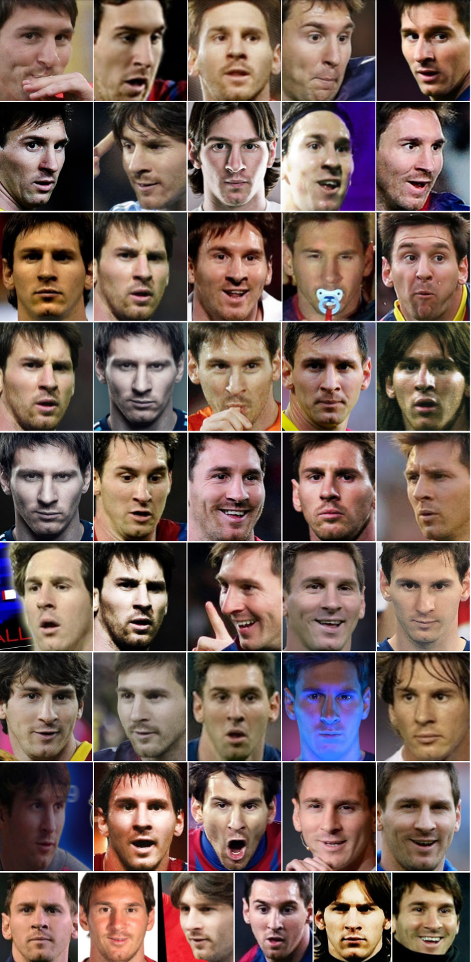
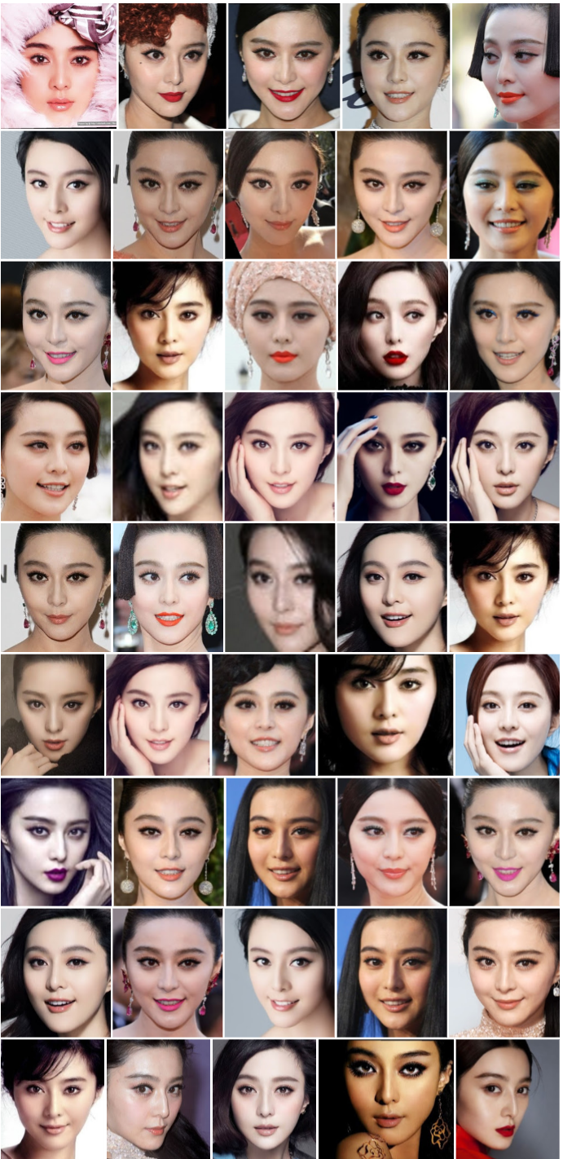
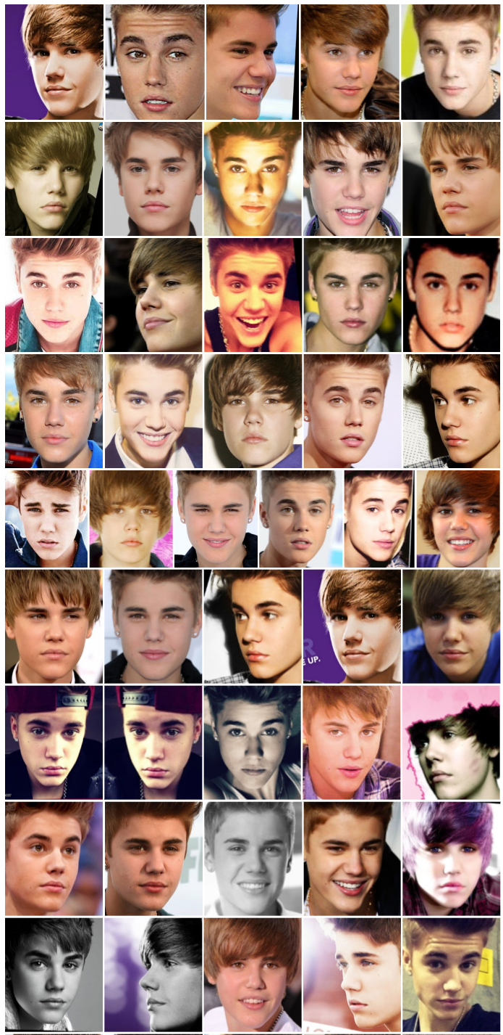
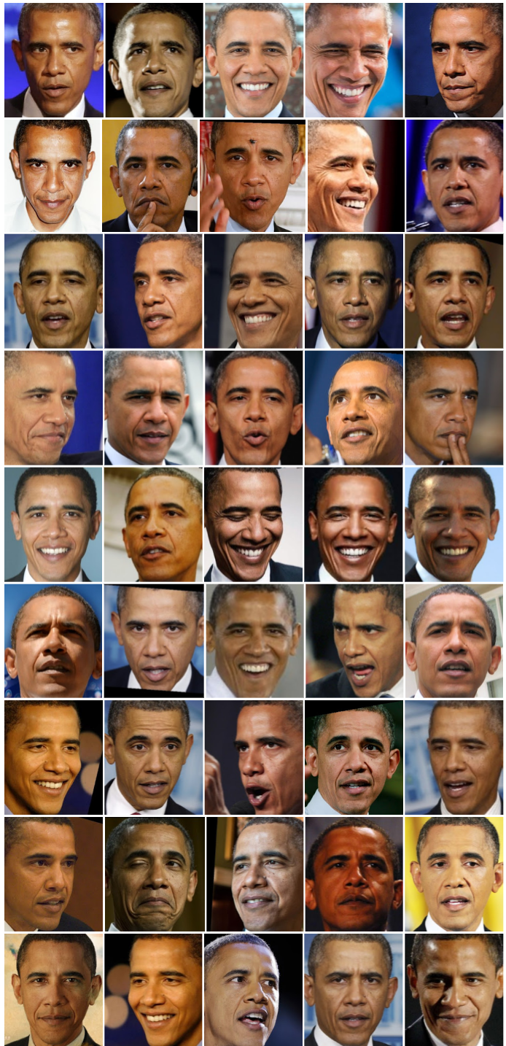
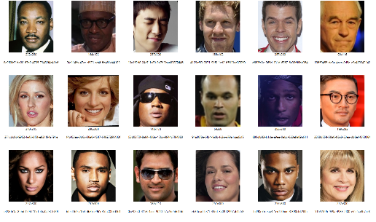

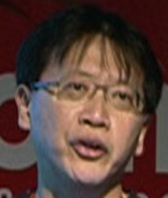


Know you at One Glance
Problem to Solve
Limited number of training images for some persons, in the scenario of large-scale face recognition
…
base set: many persons, many images per person
low-shot set : only one image per person
As shown, the training image could be faces with occlusion, drawings, or low resolution images
Great value to study one-shot visual recognition
Naturally happens when the number of persons to be recognized is very large

Slide 28

Benchmark Task – MS-Celeb-1M Challenge #2
To study this problem, we design and publish^{[1]} the following task
 | Training | Testing
Base set: 20K persons | 50-100 images/person | 5 images/person
Low-shot set: 1K persons | one image/person | 20 images/person
Goal
Build a 21K-class classifier to recognize all the persons (in total 21K) in both the base and low-shot sets
Metric
Mainly focus on the performance for persons in the low-shot set (coverage@high precision)
Keep good performance for persons in the base set
[1] http://www.msceleb.org/

Slide 29
Challenge One: Face Representation Learning
Objective: to find face representations for the low-shot classes
Solution: using the base set to train face representation model with good generalization capability
Train deep CNN model with large-scale training data
Add additional loss for better feature
Evaluation on the LFW verification task
Our base set excludes celebrities in LFW by design => good generalization capability (human 97%)

Slide 30
Improve Face Feature with Additional Loss
Many loss terms developed
Triplet Loss, Center Loss, Marginal Loss, SphereFace, Range Loss, Ring Loss, Cosine Loss
Key Ideas Behind
Reduce intra-class variance while increasing inter-class variance

Slide 31
Mei Wang and Weihong Deng. "Deep Face Recognition: A Survey." arXiv preprint arXiv:1804.06655 (2018). v7, 9/28/2018

Slide 32
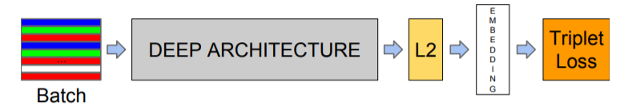
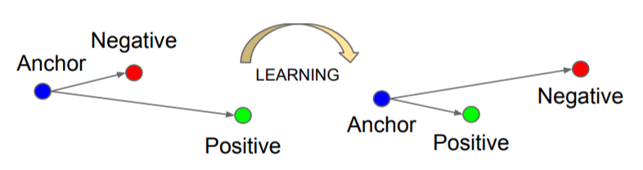
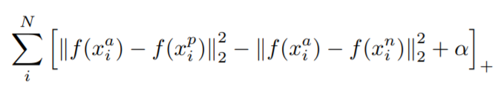
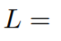
Triplet Loss
Schroff, Florian, Dmitry Kalenichenko, and James Philbin. "Facenet: A unified embedding for face recognition and clustering." CVPR 2015

Slide 33
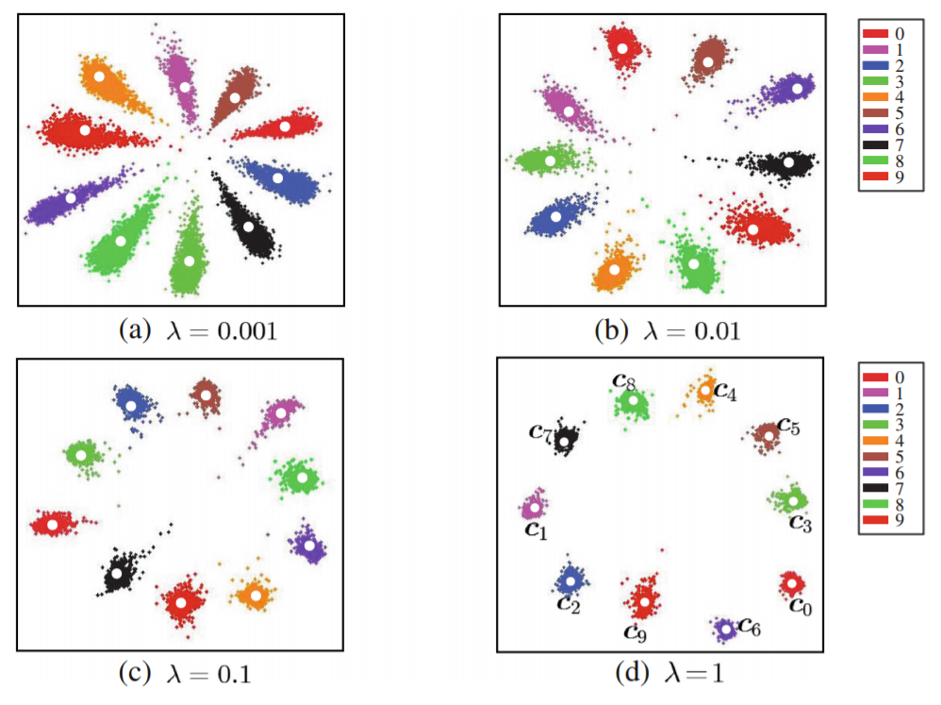
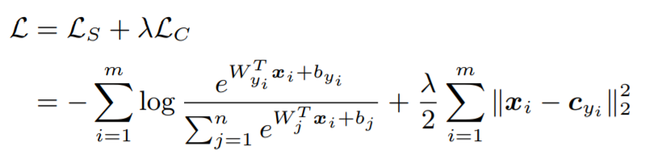
Center Loss
Wen, Yandong, Kaipeng Zhang, Zhifeng Li, and Yu Qiao. "A discriminative feature learning approach for deep face recognition." ECCV 2016.

Slide 34




Cosine Similarity Loss
Yandong Guo and Lei Zhang. "One-shot face recognition by promoting underrepresented classes." arXiv preprint arXiv:1707.05574 (2017).
Classification vector-centered Cosine Similarity (CCS)

Slide 35





Challenge Two: Classifier with Imbalanced Data
Even with very good face representation model, classifier does not perform well
ResNet-34 trained on the base set
Final classifier trained on both the base set and the low-shot set
99.8% top-1 test accuracy on the base set
About 70% top-1 test accuracy on the low-shot set, even when data boosting is applied
If we keep precision @ 99%, the recall is only about 15%
Typical CNN: AlexNet, VGG, ResNet, etc.
Chloë Grace Moretz
…
convolutional + pooling layers
fully connected layers
N-class prediction

Slide 36



Why One-Shot Classes Perform So Bad?
Logistic regression loss is additive
$$L=Σ_{i=1}^{N}cross_entropy\left(p\left(φ\left(x_{i}\right)\right),t_{i}\right)$$
You get what you provide

Slide 37



What Leads to Smaller Classification Space?
Lack of samples introduces smaller classification space
Accordingly, smaller classification space means smaller weighting vector norm for low-shot classes
* We removed the bias term to make the problem tractable.

Slide 38

Weight Vector Norm Distribution
*We remove the bias term

Slide 39

Underrepresented Classes Promotion (UP)
Underrepresented Classes Promotion
Where C_{b} is the class set for the base classes, C_{n} is the class set for the low-shot classes

Slide 40
Other Methods We Have Tried
Shrink
Equal Norm

Slide 41

Experimental Results on Our Benchmark Task
Dataset Revisit
Base set: 20K celebrities, 50-100 images per celebrity
Low-shot set: 1K celebrities, one image per celebrity for training, 20 images per celebrity for testing
Performance on low-shot classes
Red-> Green: improvement by better CNN model (AlexNet -> ResNet-34)
Green->Blue: improvement by the new loss term and data boosting

Slide 42

More Experimental Results
Metric: Coverage at high precision, test on the low-shot classes, same data boosting applied (x100)
*”Low-shot Visual Object Recognition”, Bharath Hariharan, Ross Girshick

Slide 43

Other Improvement – Generative Learning
The UP prior acts as a regularizer and treats different classes indifferently
How to take into account different intra person variance?
Generate virtual samples to span the space for low shot classes
Key idea: generate samples in feature space, rather than in image space
Zhengming Ding, Yandong Guo, Lei Zhang, Yun Fu. One-Shot Face Recognition via Generative Learning, IEEE Conference on Automatic Face and Gesture Recognition (FG), 2018

Slide 44
Summary
Face recognition – great progress made in the past five years
Large-scale datasets developed and made publicly available
Better algorithms led to better face representation
In real applications, many challenges still remain and desire for more studies
Large pose, large age variation, low resolution, etc.
Person re-identification in videos
Bias caused by improperly constructed datasets
Privacy concerns
…

Slide 45
Thanks! leizhang@microsoft.com
MS-Celeb-1M (http://msceleb.org)

Slide 46
Backup Slides

Slide 47
Challenge Two: Classifier with Imbalanced Data
Why a classifier is needed?
KNN has been widely adopted
If the feature extractor is PERFECT, KNN is the optimal solution, if not, we need a classifier to describe the partition of the feature space
 | K-Nearest Neighborhood (KNN) | Multinomial Logistic Regression (MLR)
Advantages | No additional training needed to add/remove persons | Better performance in the large-scale scenario if there are many images for each class[1,2] Computing complexity is linear to the number of classes; Weighting vectors in MLR is trained with global information;
Disadvantage | Not good for large scale Not practical to keep all the face images for every person in the gallery; If select a subset, what and how many images to select is still an open challenge; The accuracy relies on the annotation accuracy; | Additional training needed*
We train multinomial logistic regression as our classifier.
[1] Yue Wu, etc. “Low-shot Face Recognition with Hybrid Classifiers”.
[2] Yan Xu, etc. “High Performance Large Scale Face Recognition with Multi-Cognition Softmax and Feature Retrieval”.
[*] We patented technologies to train MLR very fast

Slide 48


Closer Look on KNN vs. MLR
Both the methods were tested on the development set of low-shot learning track of MSCeleb-1M
ResNet-34 trained with the all the training set of low-shot learning track of MSCeleb-1M (pool5 as feature)
Results shown in Figure-a
In Figure-a, we observe much higher coverage at high precision for MLR compared with KNN
In Figure-b, we observe that with MLR, the performance on the low-shot classes is much worse than that of the base classes
How to improve? Option A: Hybrid; Option B: Direct boosting
a
b

